Slide 1

RFPA Test Interface DLL

Slide 2
What is it?
Active-X (COM) DLL that can be used by the RFPA test applications
A set of objects that are intended to provide standardization of the DCF test results files and the GUI for the test operator
A utility that “hopefully” eliminates some of the test engineer’s work in developing / maintaining this type of functionality in each Test Application

Slide 3
Why is it necessary?
Inconsistent DCF file generation
  Use of ‘Gen’ fields
  Timing of test duration
  Bugs
Uncontrolled selection of Assembly_Types / Program Ids
  Same project uses different Assem Types: Niagara, Niagara_PCS, etc.
  Same test stage uses different Prog Ids: PreBurnin, Pre_Burn_In, 1E, etc.
Inconsistencies in the various Test Applications regarding their interface to CM Process Tracking software
  Each project may have different INI field settings

Slide 4
What does it do?
Provides standard Graphical User Interface (GUI) for production test operator
Provides data collection object that creates DCF files in required format
Interfaces with Contract Manufacture Process Tracking software

Slide 5
What doesn’t it do?
Implement Test Sequencing
  Entire test sequence implemented by the client Test Application (TestApp)
Provide Device Drivers
  TestApp is responsible for all instrument communication
Restrict the TestApp from implementing additional GUI elements, such as
  Console window showing DUT comm traffic
  Selection dialog to select DUT type (e.g, 24/48V, Cell/PCS, etc)
  Troubleshooting GUI

Slide 6
Two ways to use DLL
Operator Interface (GUI)
  When the GUI is used by the TestApp, the data collection and process tracking functions are automatically included. Therefore, it is not necessary to create any other object
Data Collection Only (TestResults class)
  When the GUI is not used by the TestApp, it is still possible to use just the DataCollection or the DataCollection with the ProcessTracking. However, it is necessary to create instances of these classes and initialize them properly (usually handled by Operator Interface class)

Slide 7
Interaction of Test App & GUI
GUI is compiled and distributed as Active-X DLL
TestApp is compiled separately into EXE
TestApp project needs to “reference” DLL
So, some functions reside in GUI DLL and other functions reside in TestApp EXE. The following slides provide details.

Slide 8
Functions of GUI
Shows Main GUI form that allows operator to initiate test and monitor measurements
Includes “PreTest” callback event to allow TestApp to implement any pre-testing functionality such as barcode scan or calibration verification
Calls ProcessCheck according to INI file settings
Includes “RunTest” callback event to allow TestApp to implement entire test sequence
Includes “RecordResult” function to allow the TestApp to update the GUI and the DCF results file with the test measurements as they occur

Slide 9
Functions of GUI (2)
Includes “AddStatusMsg” function to allow the TestApp to display any desired text in the Main GUI status region during the test sequence
Includes “PostTest” callback event to allow TestApp to implement cleanup operations after test is complete
Saves DCF file at the conclusion of Test and calls CM TestUpdate utility
Renames DCF file (according to computer name and current date/time) and optionally archives DCF file and transfers to server
Displays Pass/Fail dialog to operator

Slide 10
Functions of TestApp
Implement “PreTest” callback with logic to scan barcode, check cal status, etc.
Implement “RunTest” callback with logic to run the entire test sequence
Implement all other callbacks (such as “PostTest”), which can be empty if not needed

Slide 11
Functions of TestApp (2)
Initialize the GUI class
“Register” the callback functions by passing an object to the “AssignTestPlan” method
Call method to Show the GUI
As measurements occur, call the “RecordResult” method which updates the GUI and DCF results

Slide 12
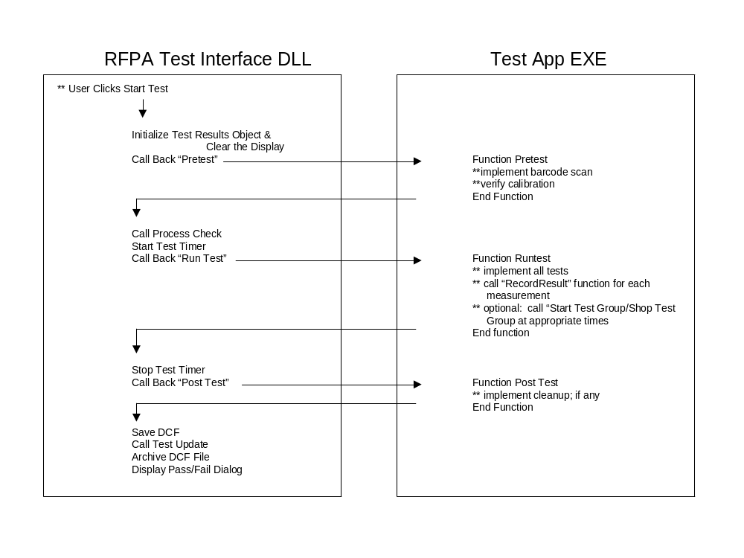
DLL & TestApp interaction diagram

Slide 13
Test Results class
Automatically handled by OperatorInterface class if the GUI is used by the TestApp; Otherwise, TestApp can use TestResults class directly
Handles the following items:
  Formatting of DCF data
  Timing of individual Test Groups
  Timing of entire Test Sequence
  Maintains counts of Number of Passing and Failing measurements
New functionality guarantees that the UUT_Type (Assembly_Type) and Program_ID fields are valid (by comparing against a data file of valid names)

Slide 14
VB demo
Placeholder slide to show Example program in VB IDE

Slide 15
INI file control
Turns Process Check on or off
[ProcessCheck]
Enable=false
RequestFile=c:\pc_request.txt
ResponseFile=c:\pc_response.txt
Program=c:\ProcessCheck\ProcessCheck.exe
[DataCollection]
Enable=false
Program=c:\ProcessCheck\TestUpdate.Exe
DataFile=c:\datafile.dcf
DCFDestinationPath=None
DCFArchivePath=None
DCFDeleteAfterTransfer=false
Celestica or other CM uses all of these settings to control interaction with their internal Process Tracking software
These settings can be used to archive DCF files and copy to remote server

Slide 16
Support
Go to RFPA Test Engineering website
  http://webcoresharepoint/RFPATE/default.aspx
RFPATestInterface Install program
  DLL Install
  Example Program
Documentation
  AndrewDataCollection document
  This presentation
Contact Rob Kossler or Rod Walker with questions

